Slide 1

Simply Online
Simple way to connect

Slide 2
Agenda
Problem Statement
Improvements from Professor’s Feedback
Team Working Agreement
Personas
Minimal Viable Product (MVP)
Architecture and Sequential Diagrams
Sprint 3 Recap
Acceptance Criteria
Sprint Summary
Sprint Backlog
Test Cases
Metrics
Retrospective
Project Demo
Live Demo

Slide 3

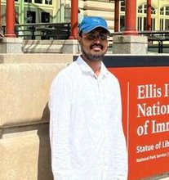
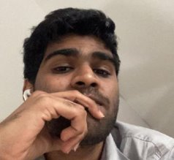
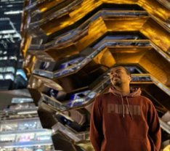
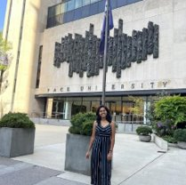

TEAM MEMBERS
Ajay Kumar
Full Stack Developer
Amarendra Reddy
Developer
Pruthvi Raj Reddy
Database Administrator
Mounik
Developer
Sreeja Reddy
Quality Analyst
Ravi Teja Reddy
Developer

Slide 4
Project Description
Simply Online is a web application that aims to simplify the process of online classes. This application allows lecturers to create virtual rooms and share the room id with their students for seamless connectivity. Using webRTC technology, simply online allows group video-sharing features and screen-sharing capabilities. This application allows lecturers to easily take attendance with just a click of a button. This platform automatically marks attendance, eliminating the need for manual tracking. Overall, simply online offers a comprehensive and user-friendly solution for educators and students to enhance their online learning experience

Slide 5
Improvement from Professor’s feedback
We incorporated the professor’s feedback and make improvements to the presentation.
By adding action items in retrospective and Average velocity chart in Metrics
Added the single slide of MVP listing all features and product backlog
API slide is added in the presentation

Slide 6
Team Working Agreement
Participation:
All the team members are expected to involve in project discussions and attend the meetings promptly. Absence during multiple meetings will affect the team’s performance and efficiency.
The team member can discuss beforehand with the team leader if he/she is going to miss the meeting or make it up for it before the next meeting is scheduled.
Communication:
The team will communicate with each other using WhatsApp group and meetings will be scheduled on Zoom.
Jira software will be used to track the assigned tasks. For any dependency on another task, mention it in the task comments.
Task management, bugs, sprint planning, and meeting minutes will be tracked in Jira.
To share the final deliverables, Google docs will be used where all the team members can edit the document.
Work Division:
The entire project work should be divided into equal parts, and equal responsibilities should be given to all the team members.
Each team member should complete their division of work before the deadline. If they are unable to complete the work on time, that hinders the performance of the entire team. If in case a team member is facing trouble and issues at some point, they can share it with others so that they can help each other and complete the work before the deadline.
Meetings:
All the team members will meet on zoom virtually every Tuesday and Friday. All the team members must be present, as attendance is mandatory unless there is an exceptional case.
The team leader would be responsible for sending meeting details and conducting the meeting.
A meeting track or meeting minutes report would be listed after every meeting to keep track of the project and its progress.
Every team member is expected to come up with ideas, participate in the discussion, and give an update on their progress for their part of the work.
TEAM MEMBERS
AJAY KUMAR
AMARENDAR
RAVI TEJA
SREEJA
PRUTHVI RAJ
MOUNIK

Slide 7
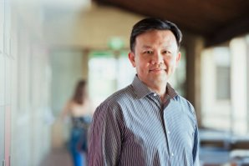
Persona
Name: Professor James​
Age: 45​
Occupation: University Professor​
Profile:
James is a tenured professor in the Computer Science department at a large university. He teaches both undergraduate and graduate-level courses and conducts research in his field. Due to the COVID-19 pandemic, his classes have been moved online, and he uses various platforms to deliver lectures, holds office hours, and communicate with his students. He lives with his spouse and two children, who are also attending school virtually.
Goals and Motivations:
Deliver high-quality lectures and course material to his students Engage his students and create a dynamic and interactive virtual classroom environment.
Ensure that his students are keeping up with the coursework and meeting their learning objectives.
Provide effective feedback and support to his students.

Slide 8

Persona
Name: Sarah
Age: 24
Occupation: College student
Profile:
Sarah is a full-time student pursuing a degree in psychology. Due to the COVID-19 pandemic, her classes have been moved online, and she uses Zoom to attend lectures, participate in group discussions, and communicate with her professors and classmates.
She lives in a small apartment with roommates and shares a room with one of them.
She has a busy schedule and often has to balance her coursework with a part-time job and other responsibilities.
Goals and Motivations:
Attend all her classes and be an active participant in class discussions Stay organized and manage her time effectively to meet assignment deadlines.
Have a reliable and user-friendly platform for attending virtual classes. Connect with her professors and classmates, and build a community within her course

Slide 9

Persona
Name: Ishika
Age: 27
Occupation: Elementary school teacher
Profile:
Ishika is a dedicated elementary school teacher who loves working with children. She has been teaching for three years and is always looking for ways to improve her classroom management and student engagement. Ishika is originally from India but moved to the US with her family when she was a child. She is fluent in English and Hindi and enjoys cooking traditional Indian dishes in her free time
Goals and Motivations:
Ishika is a dedicated elementary school teacher who loves working with children. She has been teaching for three years and is always looking for ways to improve her classroom management and student engagement. Ishika is originally from India but moved to the US with her family when she was a child. She is fluent in English and Hindi and enjoys cooking traditional Indian dishes in her free time
Ishika’s main goal is to create a safe and engaging learning environment for her students. She wants to be able to take attendance quickly and efficiently so she can spend more time teaching and less time on administrative tasks. Sarah is also motivated by the opportunity to track student attendance and identify patterns that might indicate a need for additional support.

Slide 10
MINIMal VIABLE PRODUCT

Slide 11
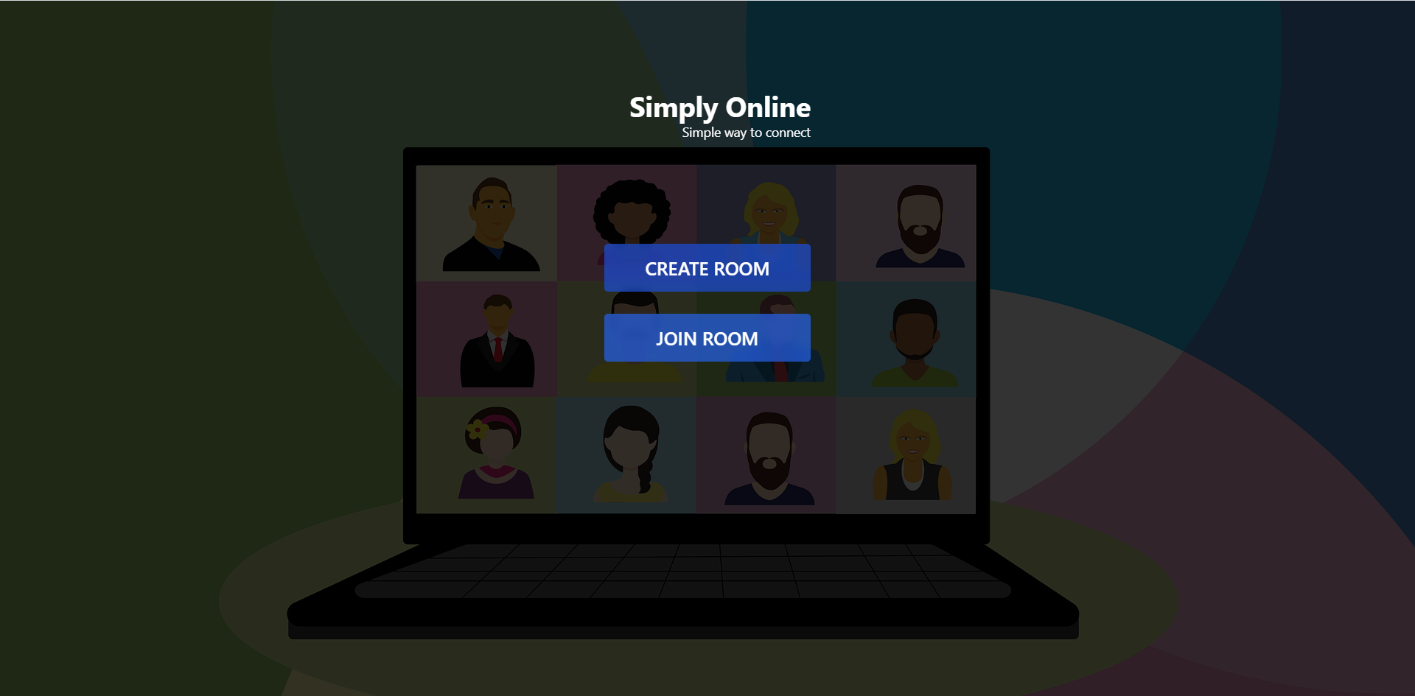
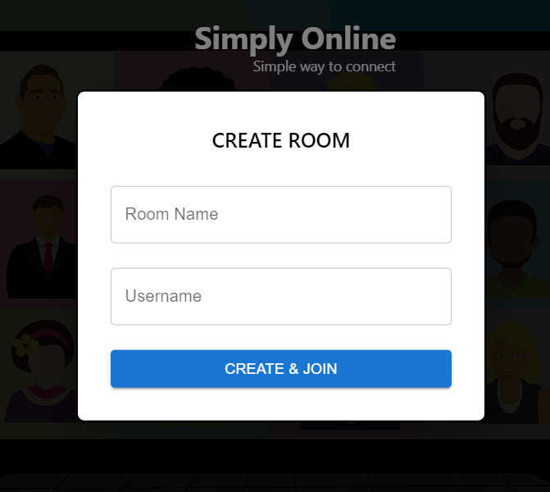
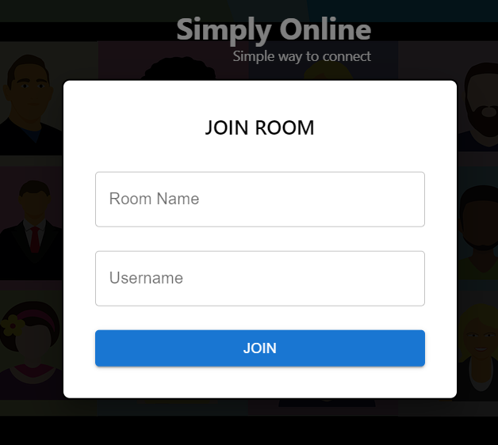
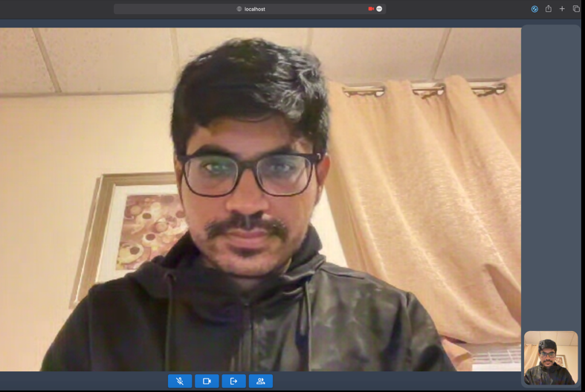
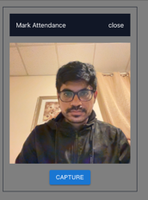
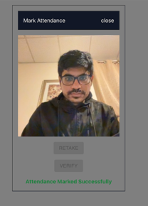
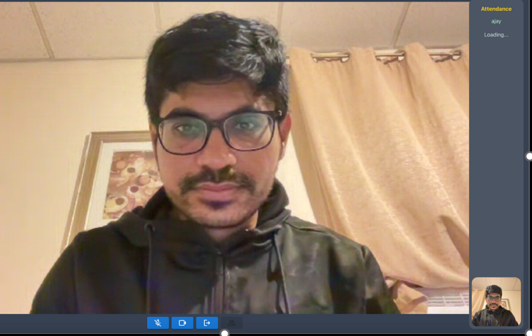
Minimal Viable Product(MVP)
Sprint-3 Recap

Slide 12
















Technologies

Slide 13
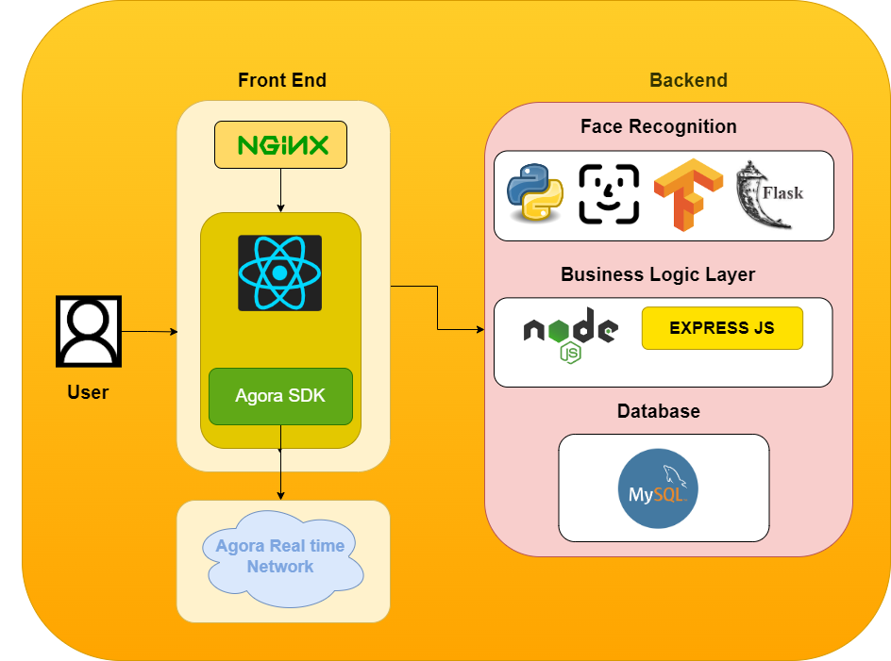
Architecture Diagram

Slide 14
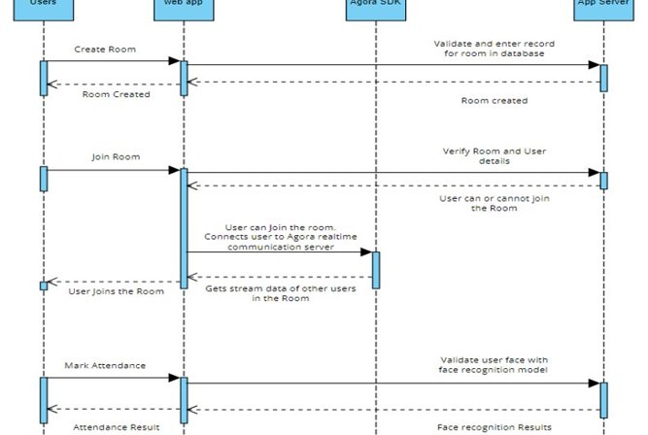
Sequence Diagram

Slide 15
Sprint-3 Recap
UX Changes for better interactivity.
Face recognition implementation using deep face.

Slide 16
Acceptance criteria
Scenario | Summary | Criteria
Implement UI to mark attendance | As a user Given Host is on the home page. Mark attendance button is enabled on the homepage. | User Experience: The host can see the mark attendance button
Create tables and stored procedures to save and retrieve data | As a user Given Host can store the data. When Host clicks on the Mark attendance button, it will create a new table with appropriate fields to store the data. Then it will call stored procedures to insert or retrieve data stored from the table. | User Experience: The host can store data and retrieve it.
Test Facial Recognition Model | As a user Given a set of images of the team. When the user clicks on the verify option, the facial recognition model is tested on the set of images. Then Model should be able to accurately identify the people already in the database and mark the attendance | User Experience: The user can easily verify attendance.

Slide 17
Acceptance criteria
Scenario | Summary | Criteria
Enable attendance marking feature for room owners | As a user Given The attendance marking feature is enabled. When the Host clicked on the mark attendance button Then Users can get verify option to mark the attendance | User Experience: The user can easily mark the attendance by verifying his picture
Test of whole application functionality | As a user Given Host can create a room. Then users can join the room When the host clicks on the mark attendance Then users will get verify option to verify their images and mark their attendance to the host | User Experience: The host can easily mark the attendance

Slide 18
Sprint -1 Summary
STORY ID | USER STORY | STORY POINTS
SIM-6 | Discussion on framework selection | 8
SIM-7 | Create a React project | 13
SIM-8 | Research on WEBRTC | 8
SIM-9 | Research on Face Recognition Implementation | 13

Slide 19
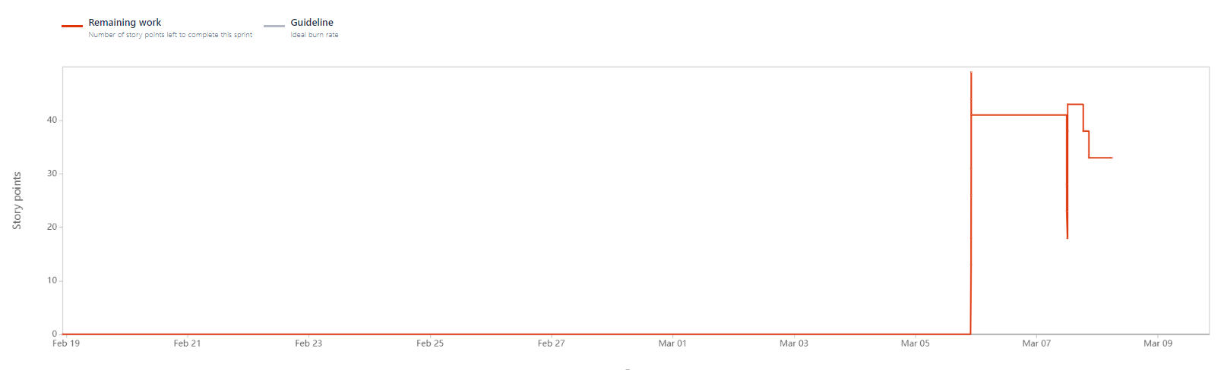
STORY ID | USER STORY | STORY POINTS
SIM-10 | Create webapp and connect to signaling server to generate ICE Candidates | 8
SIM-12 | Create UX & UI for user to create and join rooms | 8
SIM-13 | Research on SFU server for group calling feature | 8
SIM -11 | Create a connection between two peers and enable video and audio calling | 20
SIM-24 | Database analysis and Development | 5
SIM-26 | Connect business layer and database layer | 5
Sprint -2
Summary

Slide 20
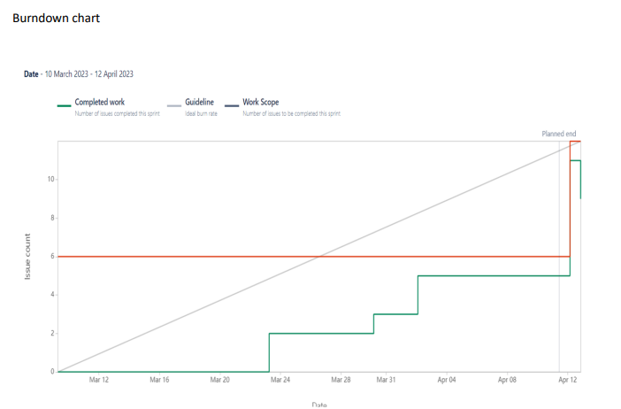
STORY ID | USER STORY | STORY POINTS
SIM-33 | Face Recognition Implementation using deep face | 40
SIM-34 | Research on Deep face | 4
SIM-35 | Create a web API using flask to connect to Face recognition | 8
SIM -36 | Implement face recognition on UI | 14
SIM-31 | UX changes for better Interactivity | 4
SIM-32 | Implement video conference UI using agora server | 16
Sprint -3 Summary

Slide 21
Sprint-4 Backlog
STORY ID | USER STORY | STORY POINTS
SIM-20 | Enable attendance marking feature to room owners | 20
SIM-30 | Test of whole application functionality | 13
SIM-17 | Implement UI to mark attendance | 13
SIM -28 | Technical paper and documentation | 20
SIM-29 | Deployment Procedure | 13
SIM-22 | Test whole application and implementation of auto attendance system | 20
SIM-21 | Enable screen sharing feature | 20

Slide 22
Test Cases
Unit to test | Scenario | Expected Result
Create Room | Create room | Room should be created and user should be redirected to Room page
Join Room | Join Existing Room with users already joined | User should be joined into the room and see other users in the room
Mic | Mic enable and disable | Mic should be enabled or disabled when user clicks on mic icon
Video | Video enable and disable | Video should be enabled or disabled when user clicks on video icon
Mark attendance Button | Enable to room owner | Visible on the screen to room owner
Face Recognition | Test face recognition model | Verify model with test images from UI

Slide 23
Completed tasks and not Completed tasks
STORY ID | USER STORY | STORY POINTS | Status
SIM-20 | Enable attendance marking feature to room owners | 20 | Done
SIM-30 | Test of whole application functionality | 13 | Done
SIM-17 | Implement UI to mark attendance | 13 | Done
SIM -28 | Technical paper and documentation | 20 | Done
SIM-29 | Deployment Procedure | 13 | Done
SIM-22 | Test whole application and implementation of auto attendance system | 20 | Done
SIM-21 | Enable screen sharing feature | 20 | In Progress

Slide 24
Metrics

Slide 25
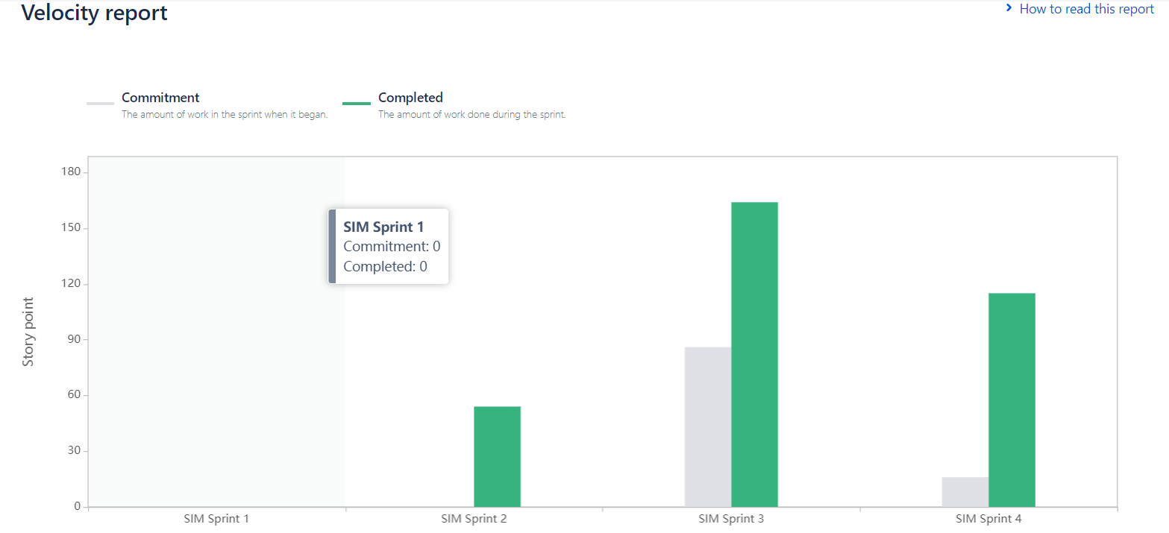
Team Velocity Report

Slide 26
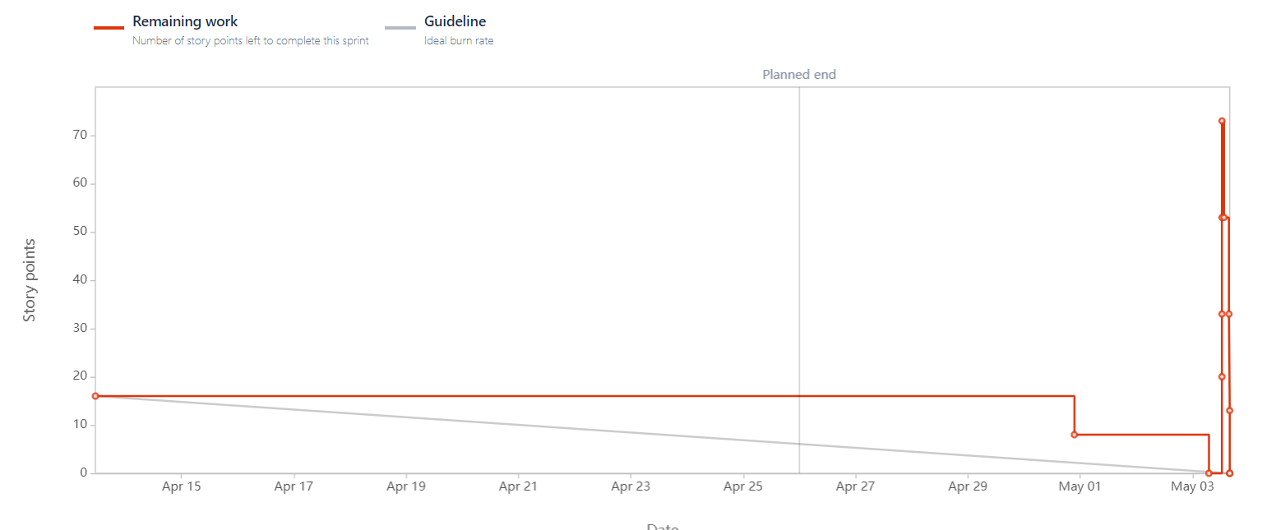
Sprint Burndown Chart

Slide 27
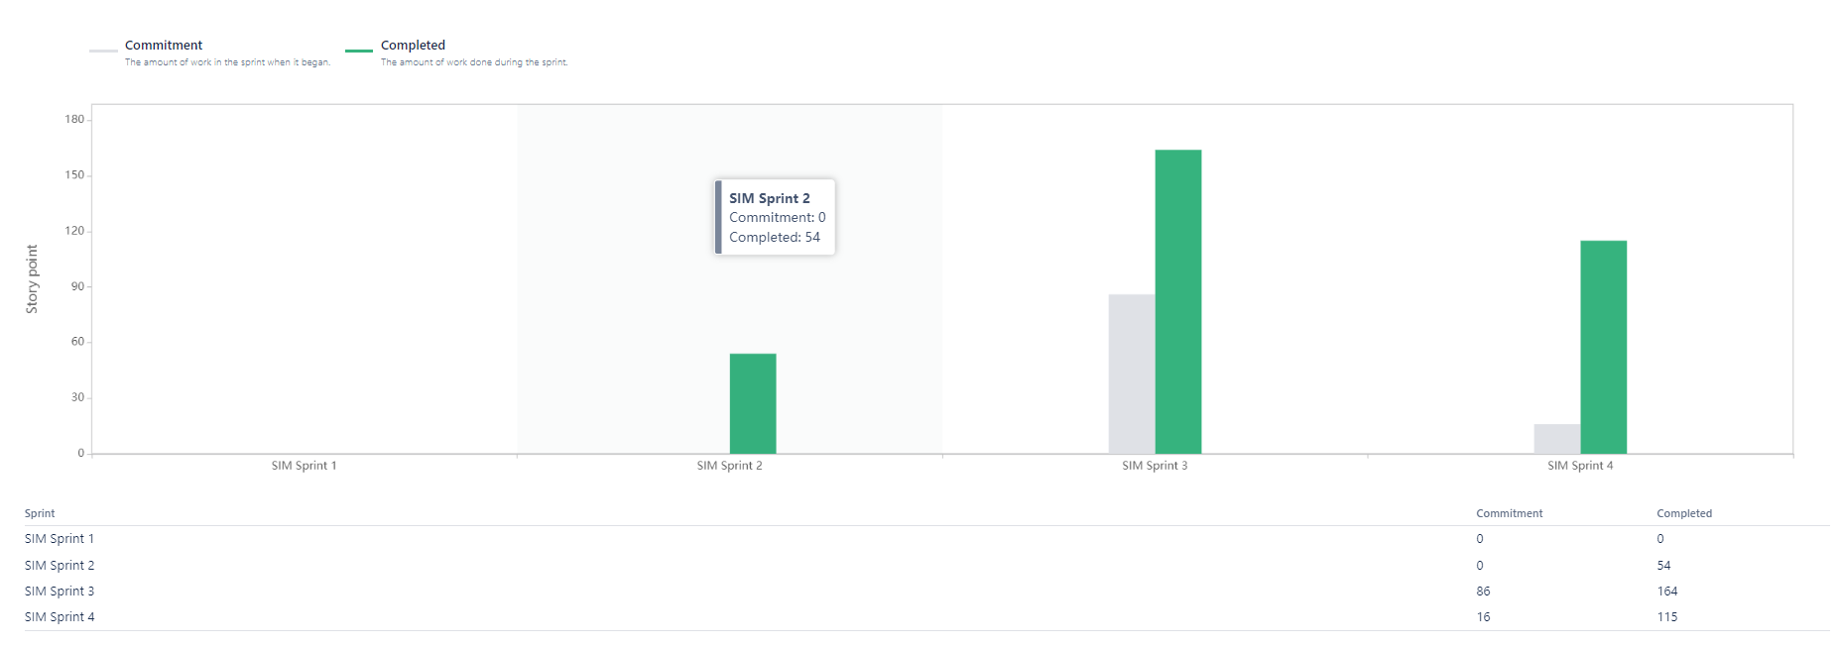
Committed and Completed Ratio

Slide 28
Retrospective
What went well:
Completion of work on time
Successfully resolved any issues or bugs that arose during the sprint
What didn’t go well:
Team communication or collaboration was not effective
Action Steps:
Improving communication among team members by implementing regular meetings
Regularly reviewing progress towards project goals and making sure that work is on track

Slide 29
Sprint - 5
STORY ID | USER STORY | STORY POINTS
SIM-39 | Mark Attendance button Production Deployment | 40
SIM-38 | User Authentication and User Authorization | 20
SIM-40 | Test live application with many users | 20

Slide 30

Group call

Slide 31
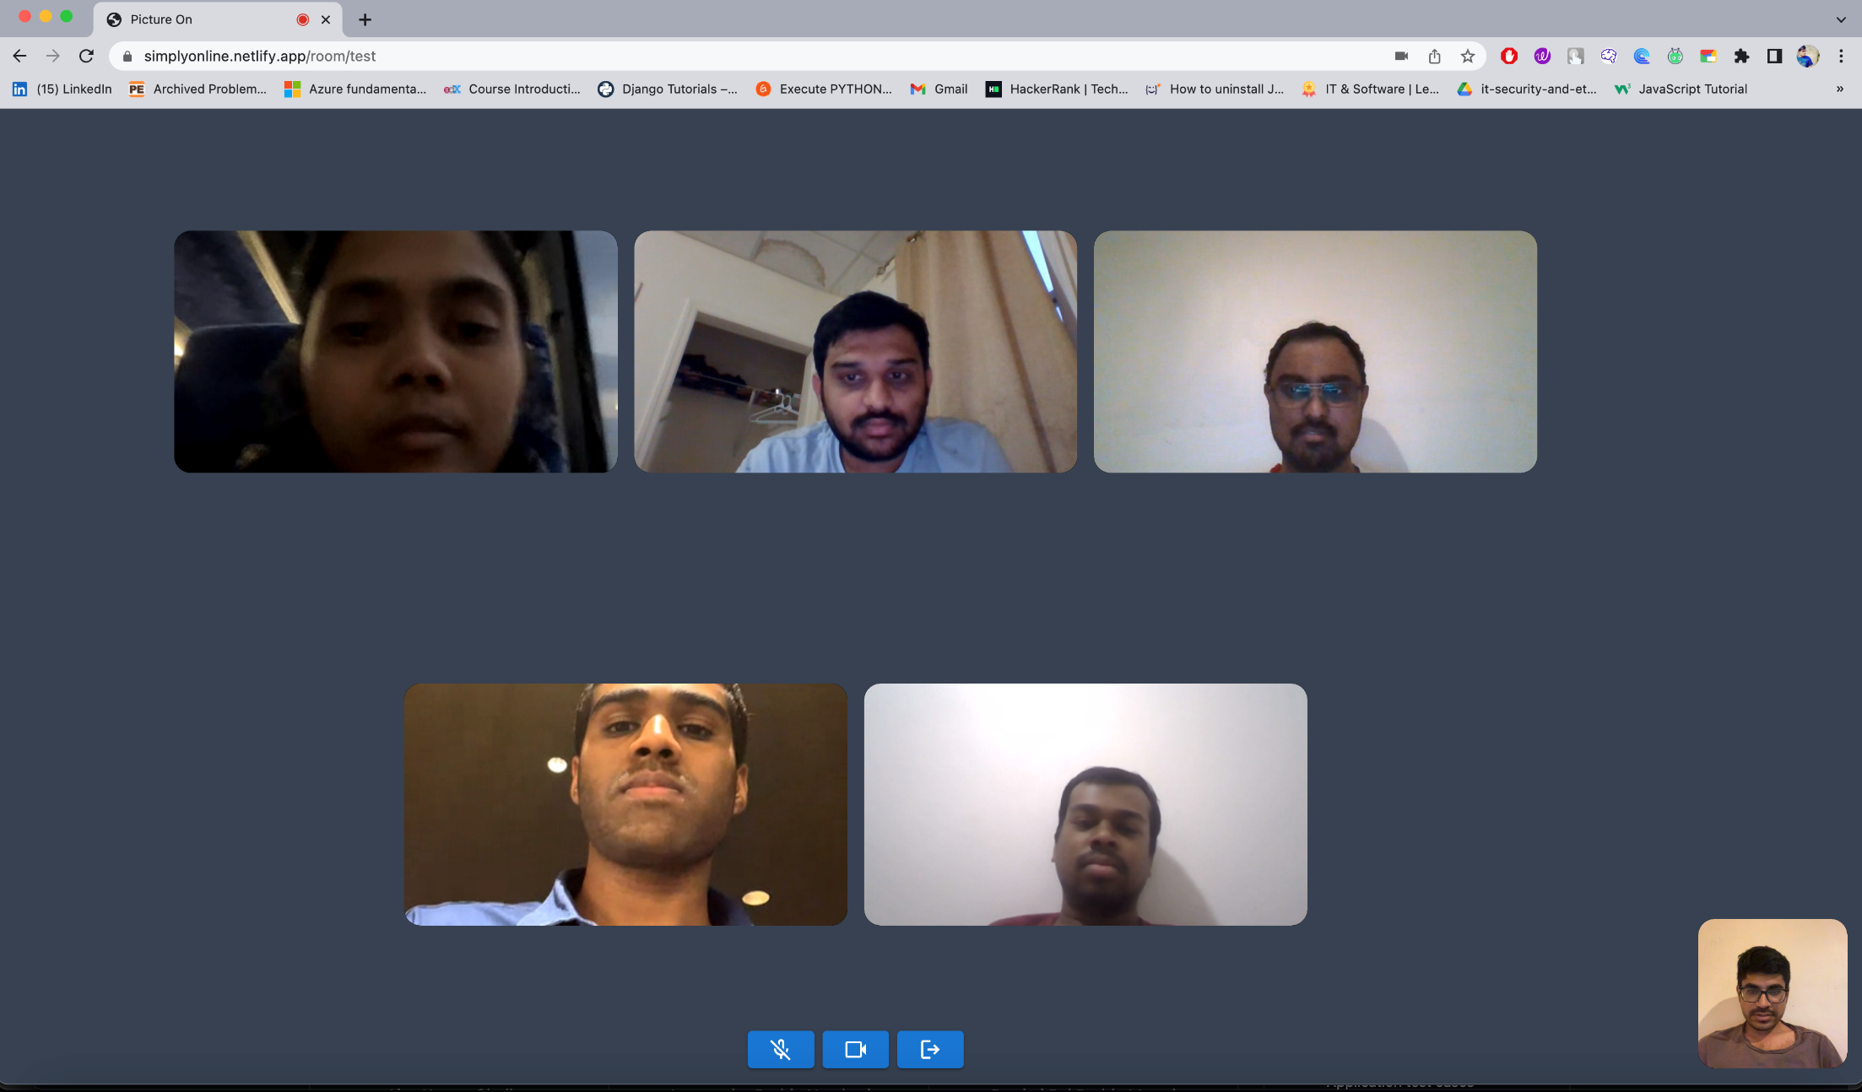

Slide 32
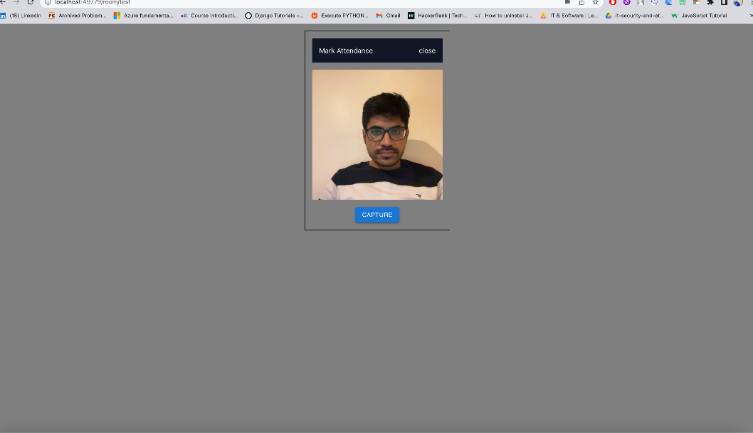
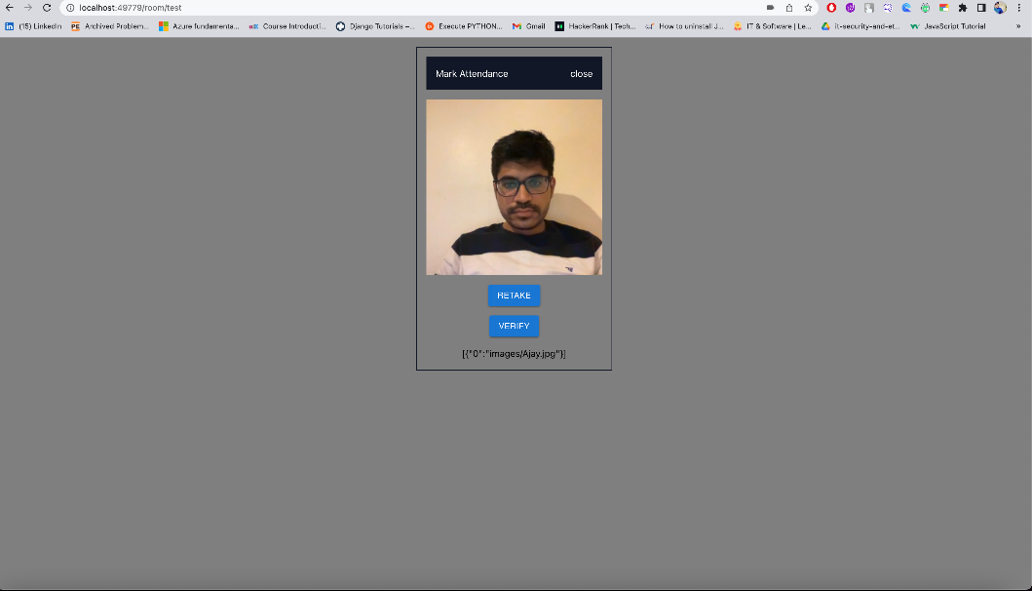
Mark Attendance/verify
This screen allows user to capture the photo and verify that it is the same user or not

Slide 33
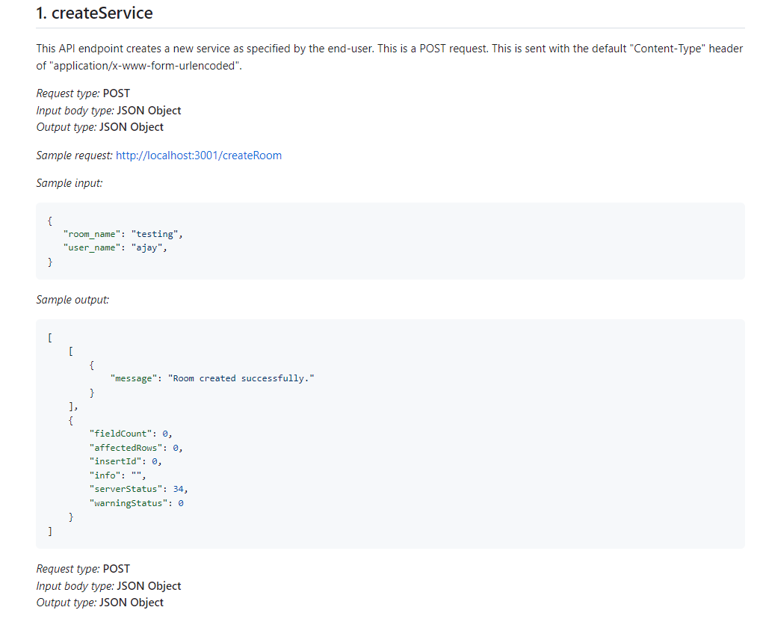
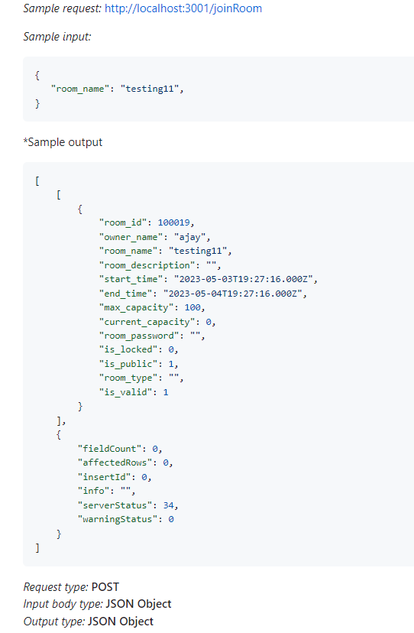
API’s

Slide 34
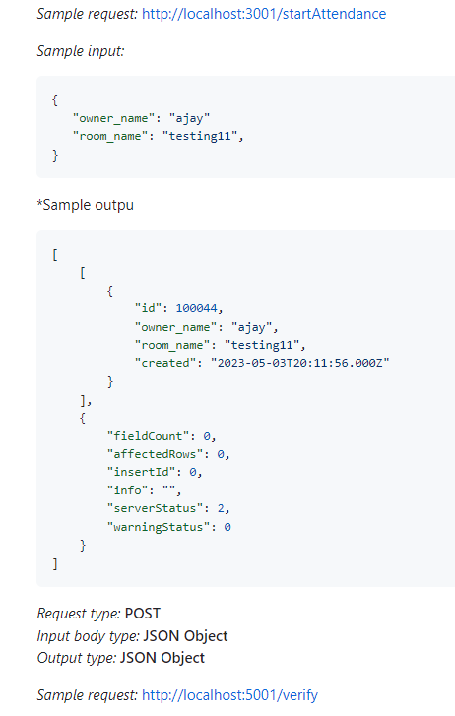
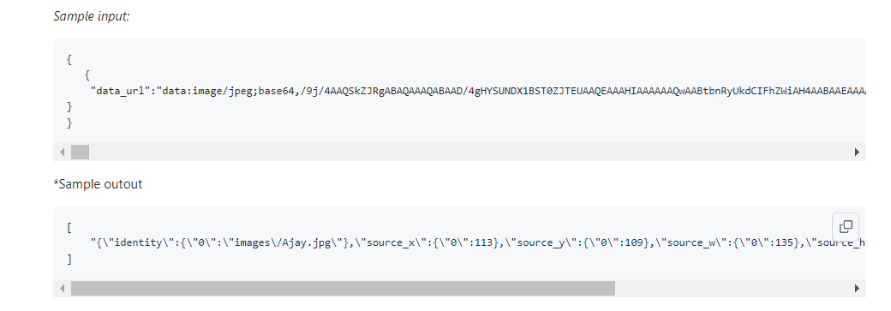
Api’s

Slide 35
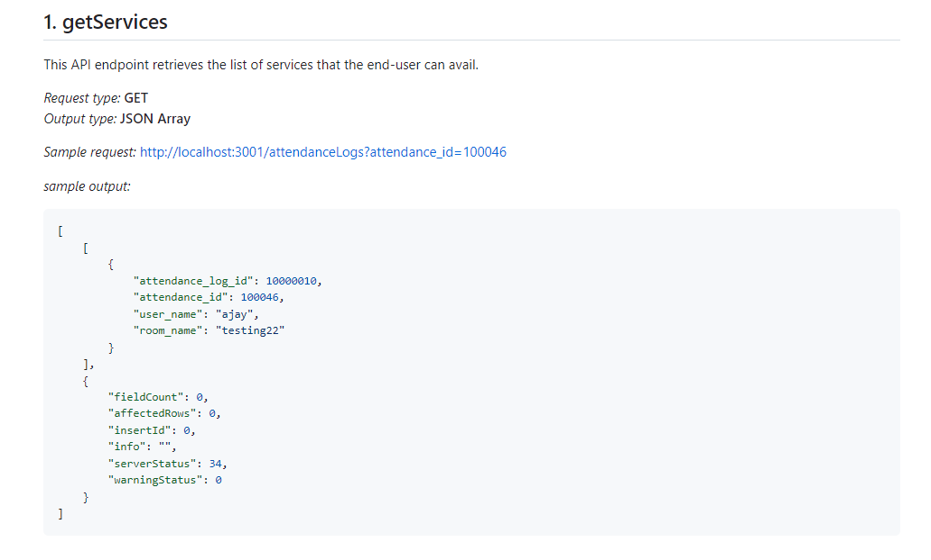
Api’s

Slide 36
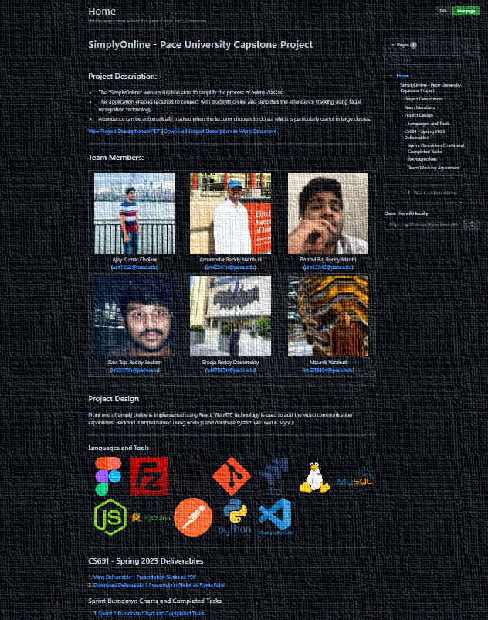
WIKI PAGE
https://github.com/htmw/SimplyOnline/wiki

Slide 37
Demo Link
https://www.youtube.com/watch?v=iP-q_YyqgfU&ab_channel=AmarendraReddyNamburi

Slide 38
Thank You

